Slide 1
Temporal Neighborhood Discovery using Markov Models
Sandipan Dey, Vandana Janeja,
Aryya Gangopadhyay

Slide 2
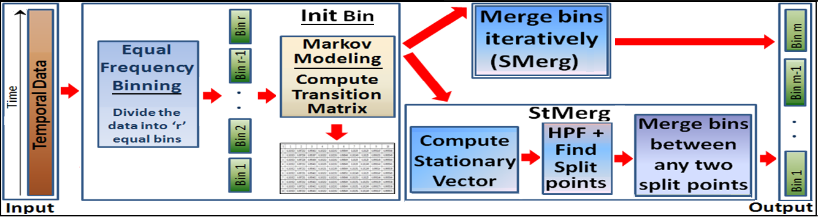
Schematic Diagram

Slide 3
Initial Markov Modeling
Normalize the Temporal Dataset
Equal Frequency Binning to get initial equi-
depth bins
Obtain Temporal Summarization
Compute Transition Probability Matrix
using different distance measures

Slide 4
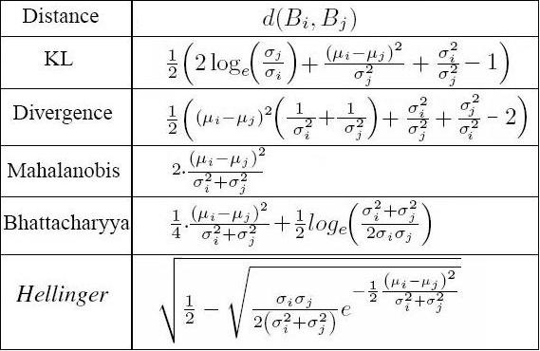
Distance Measures

Slide 5
SMerg
Find the adjacent bins with maximum
similarity
Iteratively merge the maximum similar
adjacent bins
Stop merging if similarity less than a
threshold

Slide 6
StMerg
Compute Markov Stationary Distribution
from the Transition Matrix
Use DFT as High Pass Filter to find Split
points
Merge all bins in between successive spilt
points

Slide 7
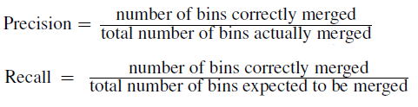
Accuracy Measures

Slide 8
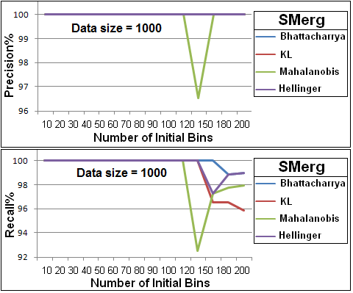
Results

Slide 9
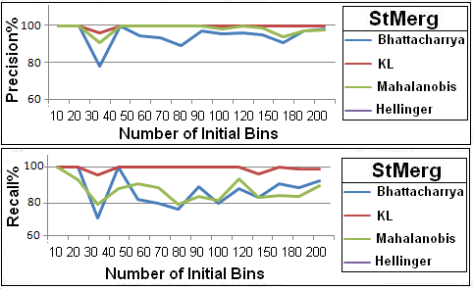
Results

Slide 10
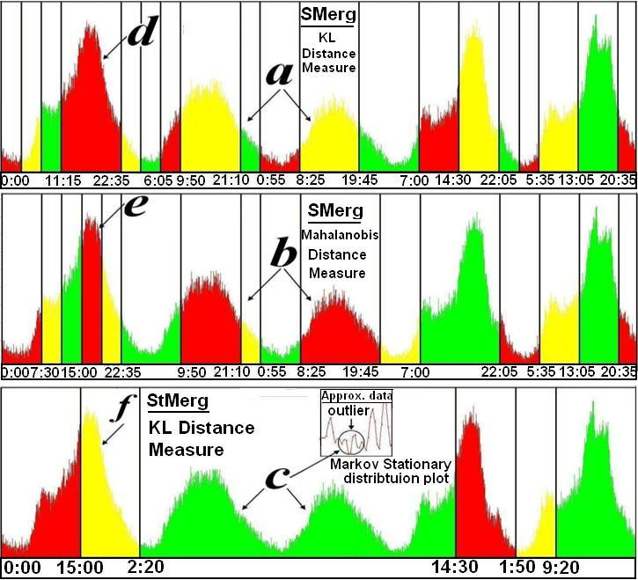
US-50-East

Slide 11
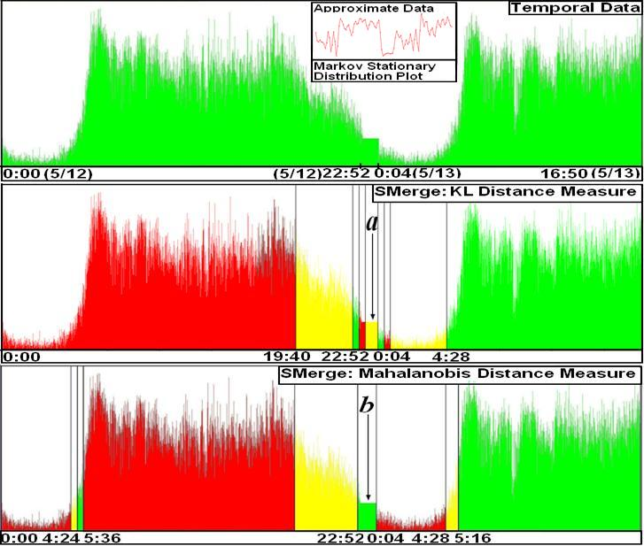
I-395

Slide 12
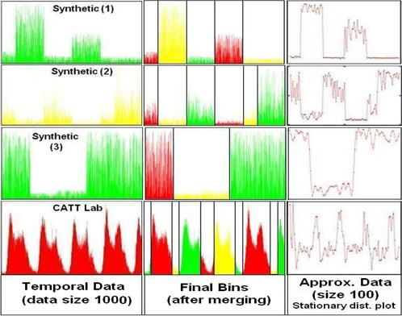
Approximation

Slide 13
Questions

